Slide 1
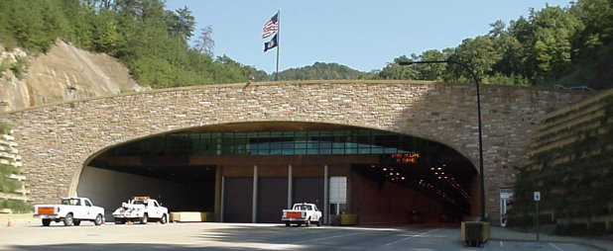
The Cumberland Gap Tunnel Fast Track Pavement Replacement
History and Repair

Slide 2
History Review
Original highway constructed in 1916
Replaced a 2.3 mile section of US 25E known as Massacre Mountain
NPS accredited with the first discussion of a tunnel in 1956
Following geological studies and surviving funding issues, excavation of a pilot tunnel began in 1985 with construction to follow on the NB Tunnel on June 21, 1991

Slide 3
History Review
CGT was completed at a cost of $280M
CGT opened to traffic on October 18, 1996
Current AADT of 22,400
Total length: 4600 feet
Height: 30 feet
Width: 36 feet
Number of lanes: 4
http://cgtunnel.com

Slide 4

What we didn’t see…

Slide 5
What we discovered…
The Pilot Tunnel took two years to drill
Caverns as tall as 85 ft
A lake of water 30 ft deep
Springs produce approximately 450 GPM of water regardless of weather

Slide 6
What we did…
Line each bore with a PVC membrane covered with 10” concrete
Install 15” groundwater drains isolated from the 12” roadway drains

Slide 7
What we designed…

Slide 8

Problem solved…

Slide 9
A New Challenge…
2001 – CGTA requested a pavement inspection due to possible slab settlement in the SB tunnel
2002 – URETEK foam was injected into the settled areas
2005 – GPR was used to locate voids beneath the pavement

Slide 10

A New Challenge…
What happened to the subgrade…

Slide 11

A New Challenge…
Calcium deficient groundwater dissolved the limestone base

Slide 12
2007 Project Information
CID | 072280
Contract Amount | $786,098.62
County | Bell
Project Number | FD04 007 025E 000-001
Work Type | Bridge Repairs
Prime | Bluegrass Contracting Corporation

Slide 13
2007 Repair Area…
CGT Repair Locations
Location | Station |  | Dimensions
 | From | To | Length (FT) | Width (FT) | Area (SQ FT) | Area (SQ YD)
Completed in 2007
SB | 122+17 | 123+37 | 120 | 30 | 3,600 | 400

Slide 14
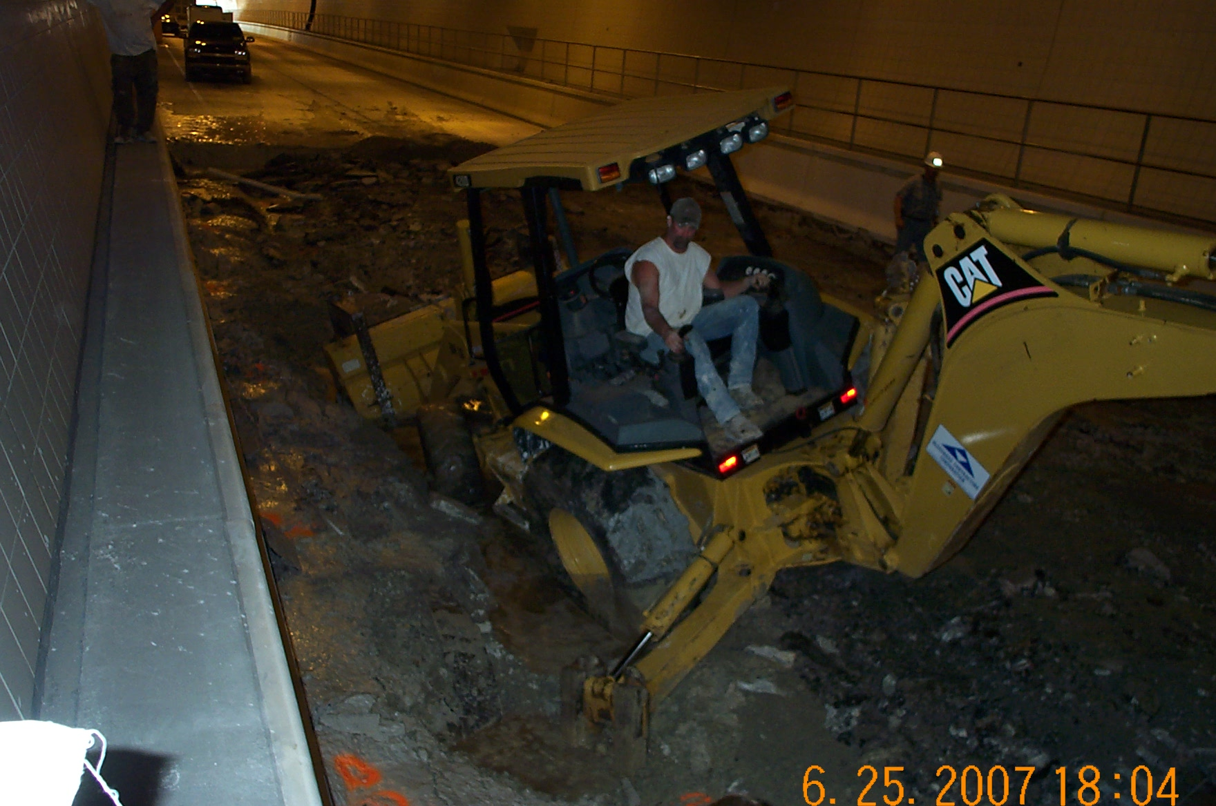
2007 Photo…

Slide 15
The Solution and Result…
The solution…replace the limestone with inert granite
Consisted of replacing 400 SY of pavement and subgrade
Constructed a concrete dam to control / prevent migration of the aggressive water
Resulted in approximate 6 week complete closure of the SB Bore

Slide 16
2012 Project Information
CID | 111052
Contract Amount | $1,523,316.10
County | Bell
Project Number | STP 0251 (028)
Work Type | Grade & Drain with PCC Pavement
Prime | Hinkle Contracting Company, LLC

Slide 17
2012 Repair Area…
CGT Repair Locations
Location | Station |  | Dimensions
 | From | To | Length (FT) | Width (FT) | Area (SQ FT) | Area (SQ YD)
Completed in 2012
SB | 121+83 | 122+27 | 44 | 30 | 1,320 | 147
SB | 127+37 | 129+32 | 195 | 30 | 5,850 | 650
SB | 137+82 | 140+00 | 218 | 30 | 6,540 | 727
NB | 120+46 | 123+36 | 290 | 30 | 8,700 | 967
NB | 126+78 | 129+03 | 225 | 30 | 6,750 | 750
NB | 134+76 | 139+52 | 476 | 30 | 14,280 | 1,587

Slide 18
The Result…
Consisted of replacing 4,827 SY of pavement and subgrade
Constructed concrete dams to control / prevent migration of the aggressive water
Resulted in approximately 4.5 months of alternating closures of the NB and SB Bores

Slide 19
2014 Project Information
CID | 141009
Contract Amount | $3,488,000.00
County | Bell
Project Number | FD04 SPP 007 025E 000-001
Work Type | JPC Pavement Repairs
Prime | MAC Construction & Excavating

Slide 20
2014 Repair Area…
CGT Repair Locations
Location | Station |  | Dimensions
 | From | To | Length (FT) | Width (FT) | Area (SQ FT) | Area (SQ YD)
Completed in 2014
NB | 118+99 | 120+46 | 147 | 30 | 4,410 | 490
NB | 123+36 | 126+78 | 342 | 30 | 10,260 | 1,140
NB | 129+03 | 134+76 | 573 | 30 | 17,190 | 1,910
NB | 139+52 | 143+50 | 398 | 30 | 11,940 | 1,327
SB | 118+55 | 121+83 | 328 | 30 | 9,840 | 1,093
SB | 123+37 | 127+37 | 400 | 30 | 12,000 | 1,333
SB | 129+32 | 137+82 | 850 | 30 | 25,500 | 2,833
SB | 140+00 | 143+50 | 350 | 30 | 10,500 | 1,167

Slide 21
Project Details…
Anticipated 180 days
August 19, 2014 - Fixed Completion Date for bore closures
October 1, 2014 – Overall Fixed Completion Date

Slide 22
Project Details…
Consisted of replacing 11,293 SY of pavement and subgrade
A+B Bid to encourage fast track construction and limit disruption to traffic
Resulted in approximate 34 days of alternating closures of the NB and SB Bores

Slide 23
2014 Bid Amounts
Company | Total
MAC Construction | $ 3,488,000.00
Bluegrass Construction | $ 3,849,988.25
Hinkle Contracting | $ 4,284,150.66

Slide 24
2014 Project Days
Company | Quantity | Days | Total
Hinkle Contracting | $ 5,000.00 | 150 | $ 750,000.00
Bluegrass Construction | $ 5,000.00 | 140 | $ 700,000.00
MAC Construction | $ 5,000.00 | 30 | $ 150,000.00

Slide 25

How fast is fast?
Notes:
Everyone wants fast!

Slide 26
2014 Project Timeline
Project Dates
Letting | 01/10/14
Award | 01/14/14
Notice to Proceed | 02/19/14
Work Began | 02/21/14
Work Completed | 08/19/14

Slide 27
Approach…
Vision
Prepare
Implement
Challenge

Slide 28
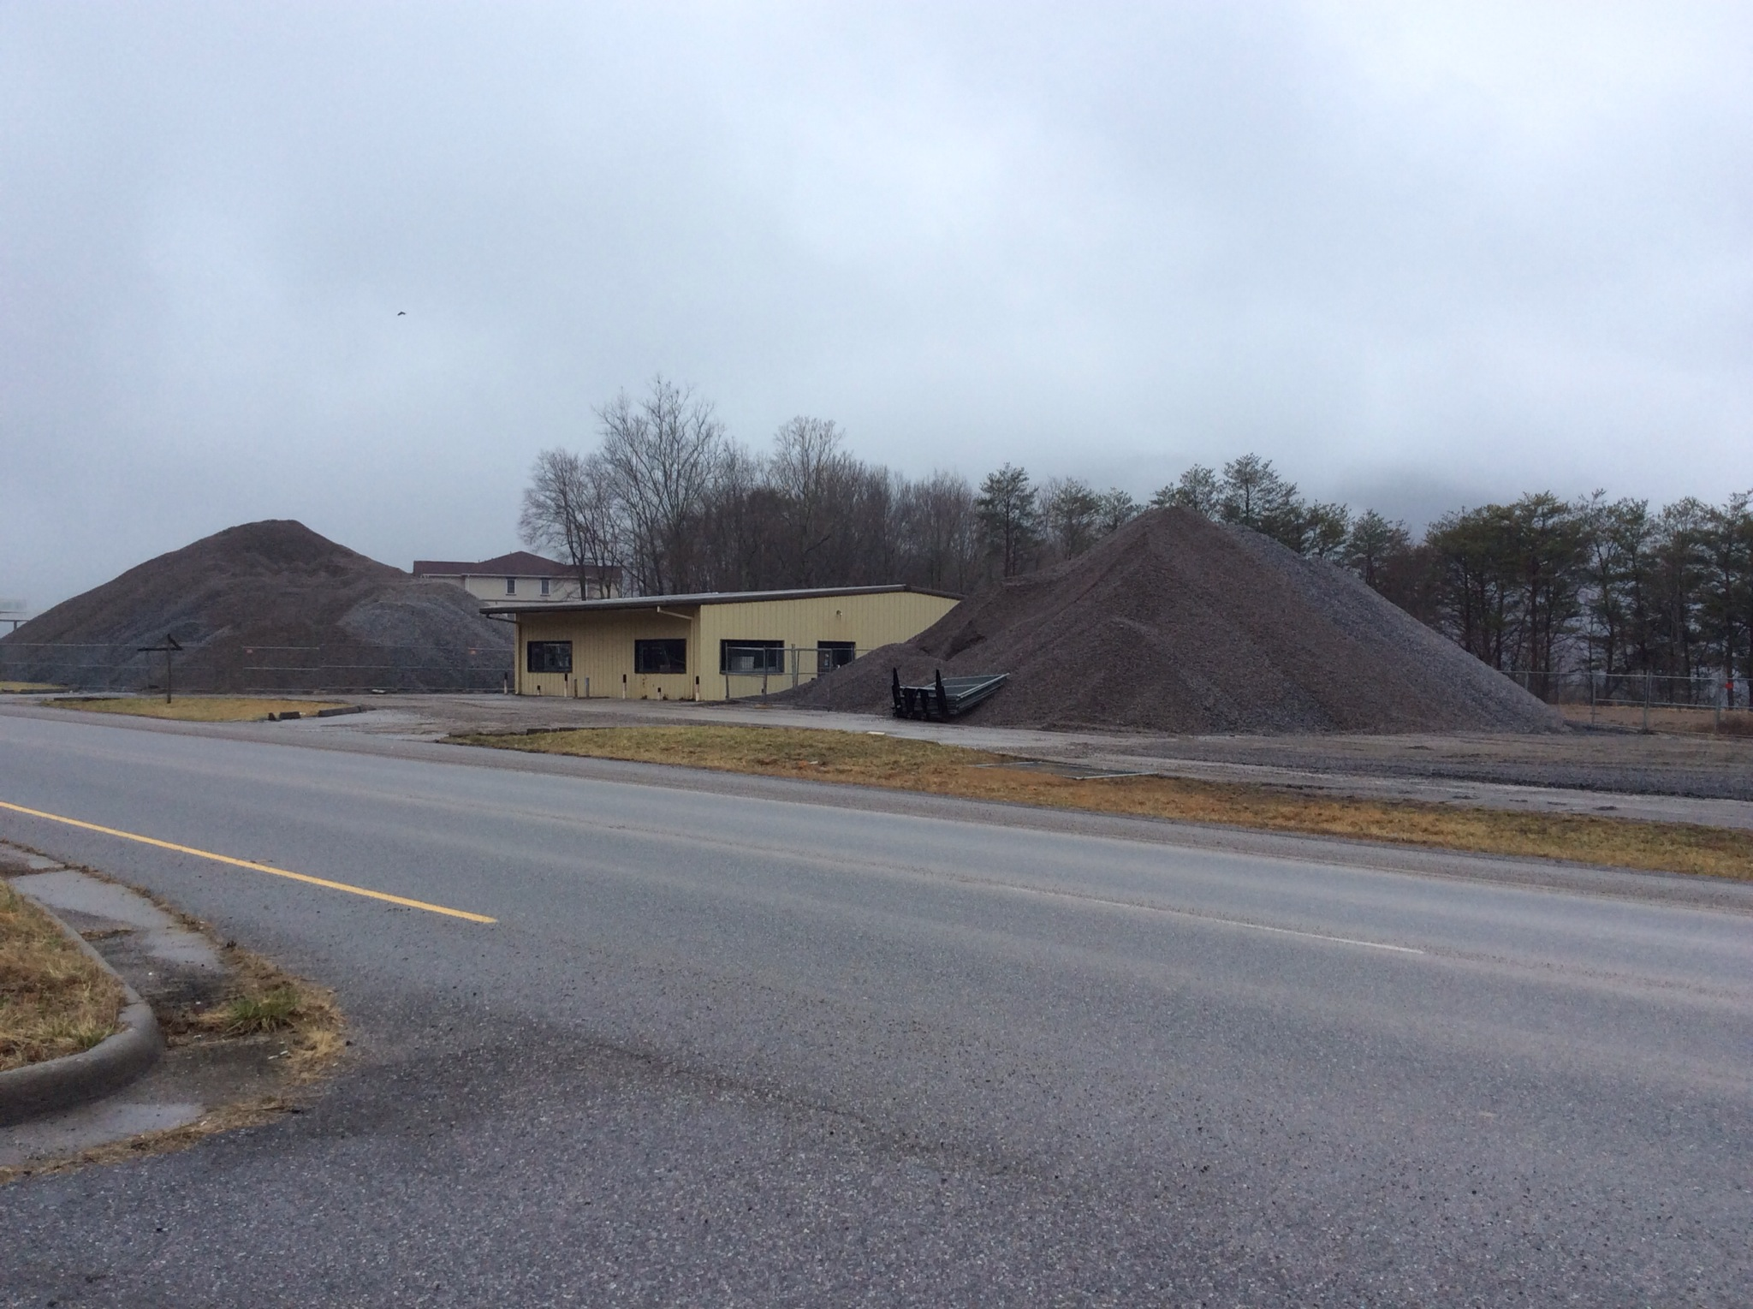
Stockpile Material
Granite deliveries began on March 3, 2014
More than 21,000 Tons of Granite

Slide 29
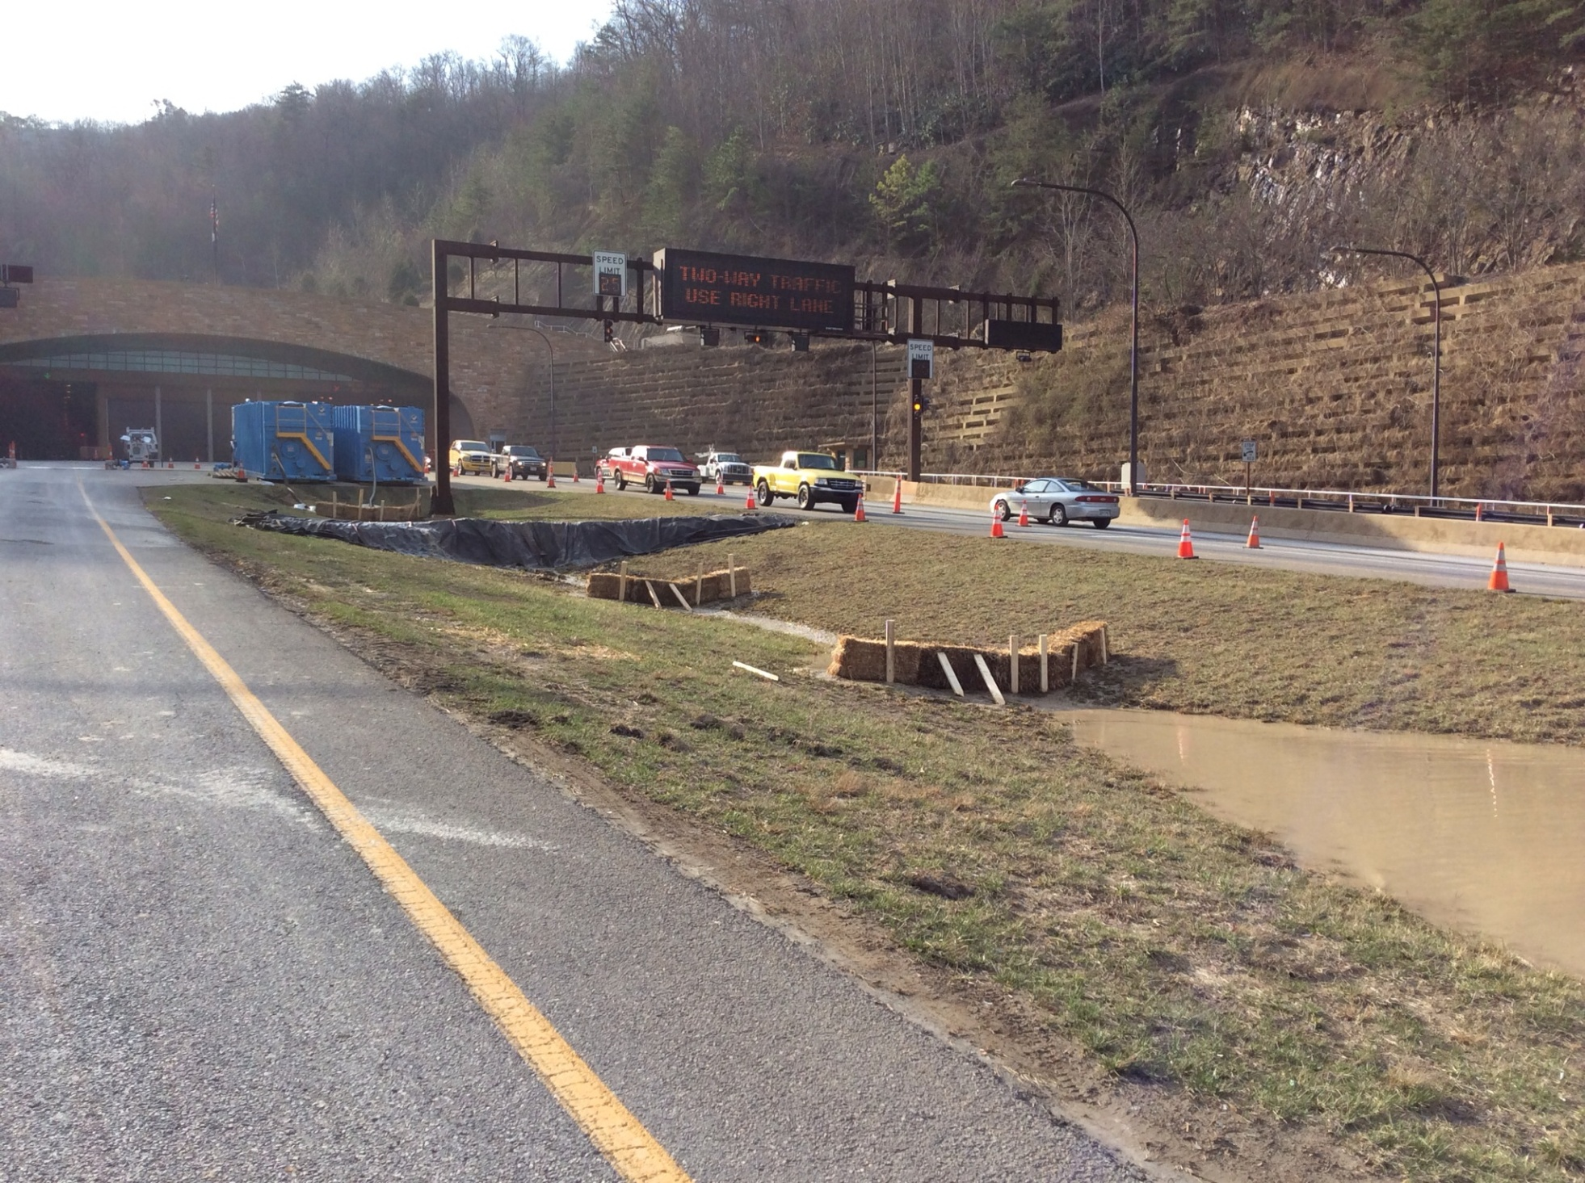
Dewatering Plan

Slide 30
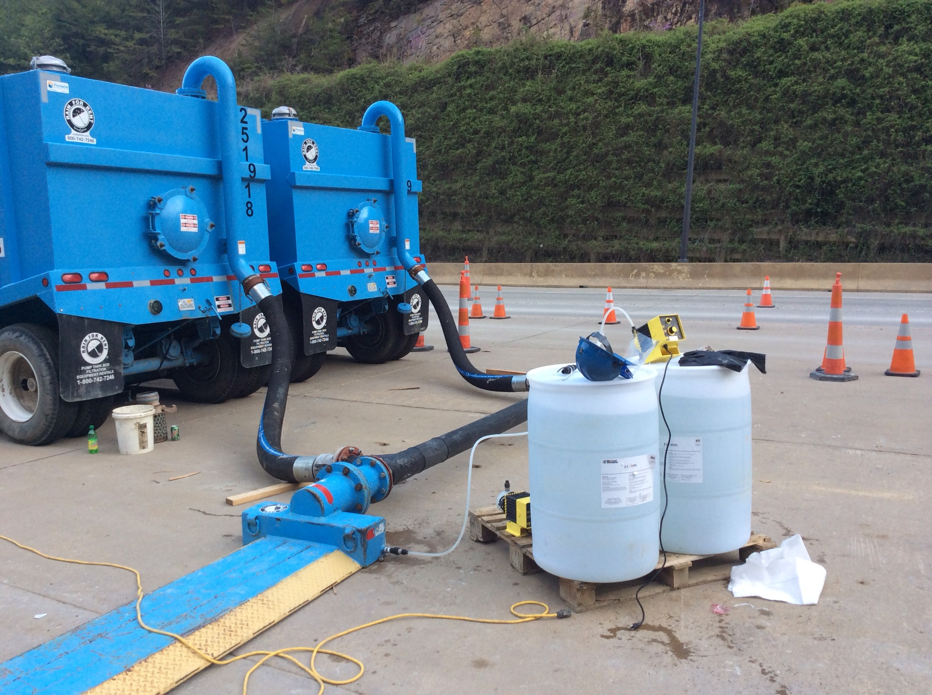
Aluminum Chloride Treatment

Slide 31
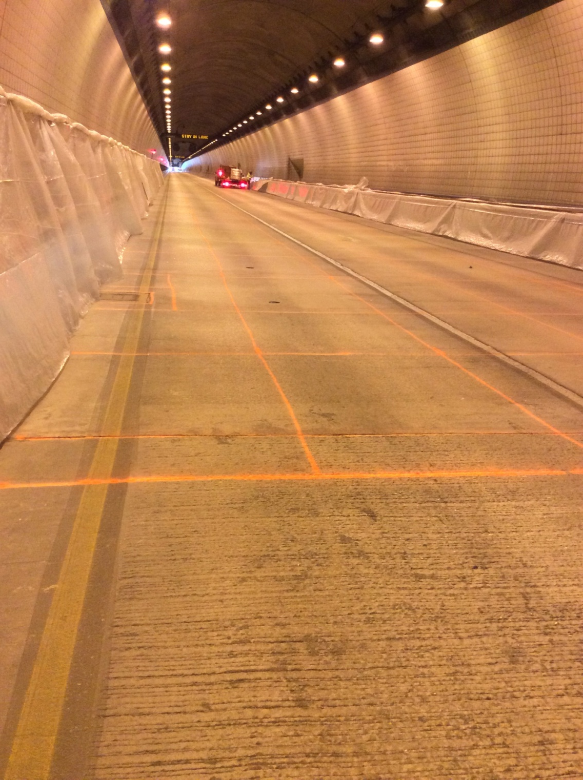
Pre-Mark for Sawing
Notes:
6’ X 6’ sections

Slide 32
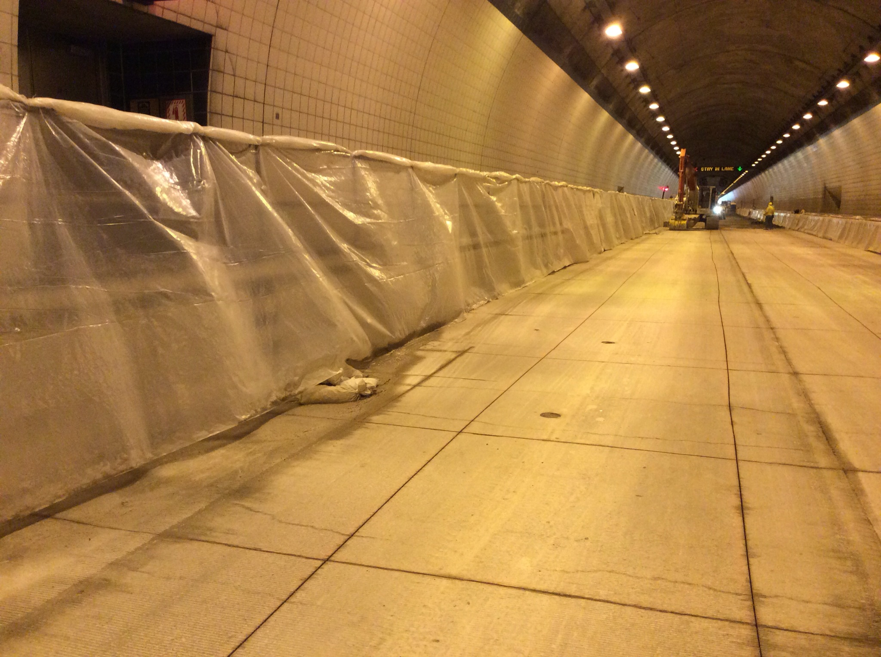
Sawed Pavement

Slide 33
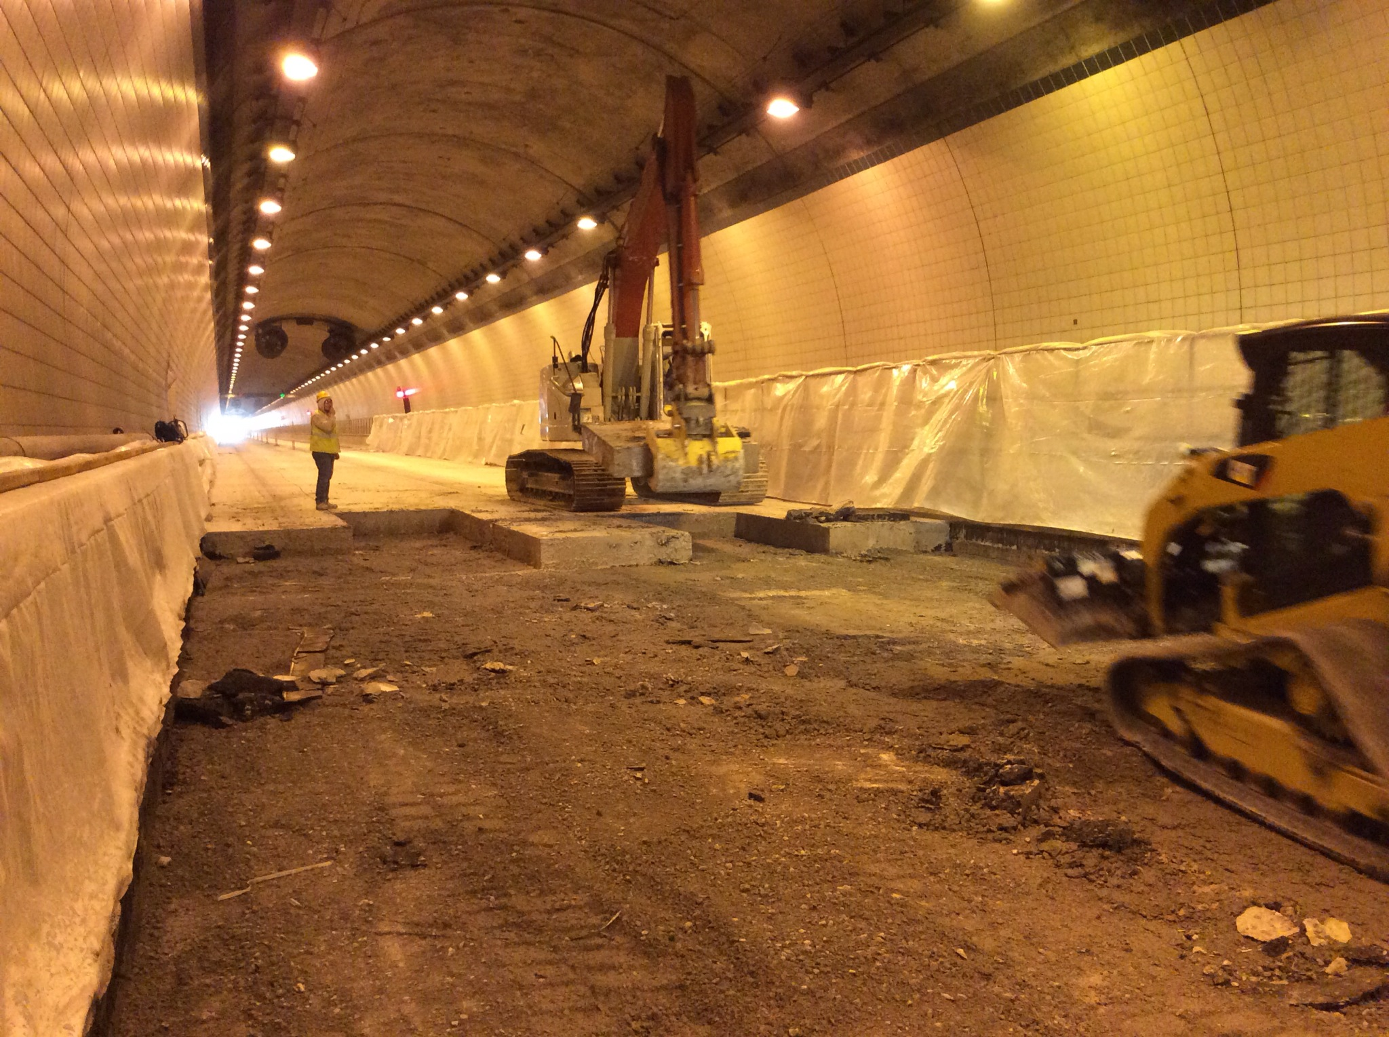
Slab Removal

Slide 34
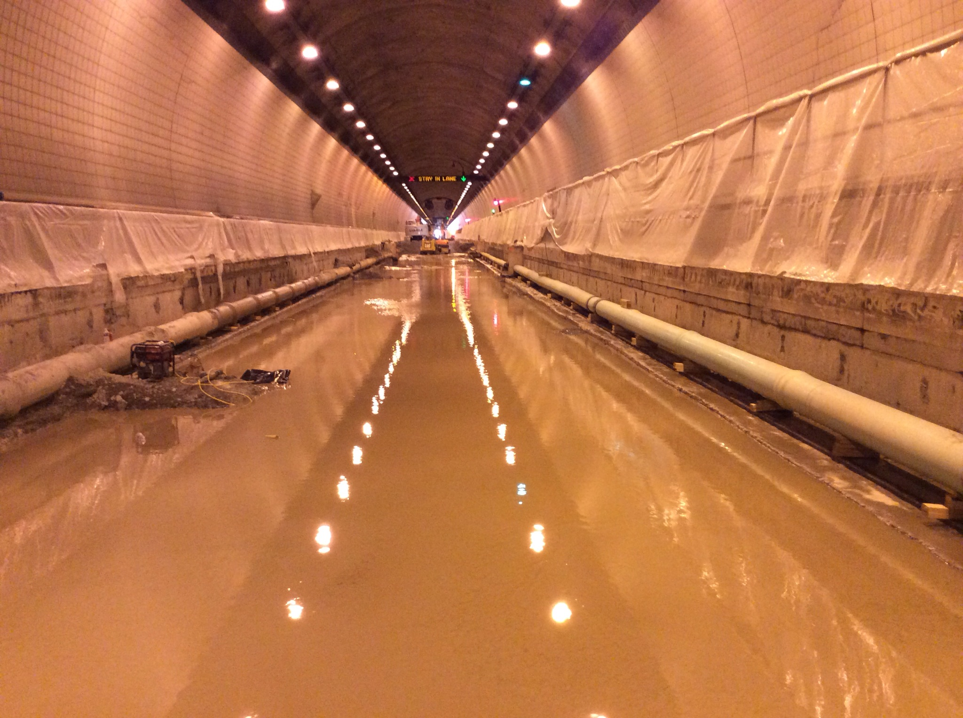
Water Filled Excavation

Slide 35
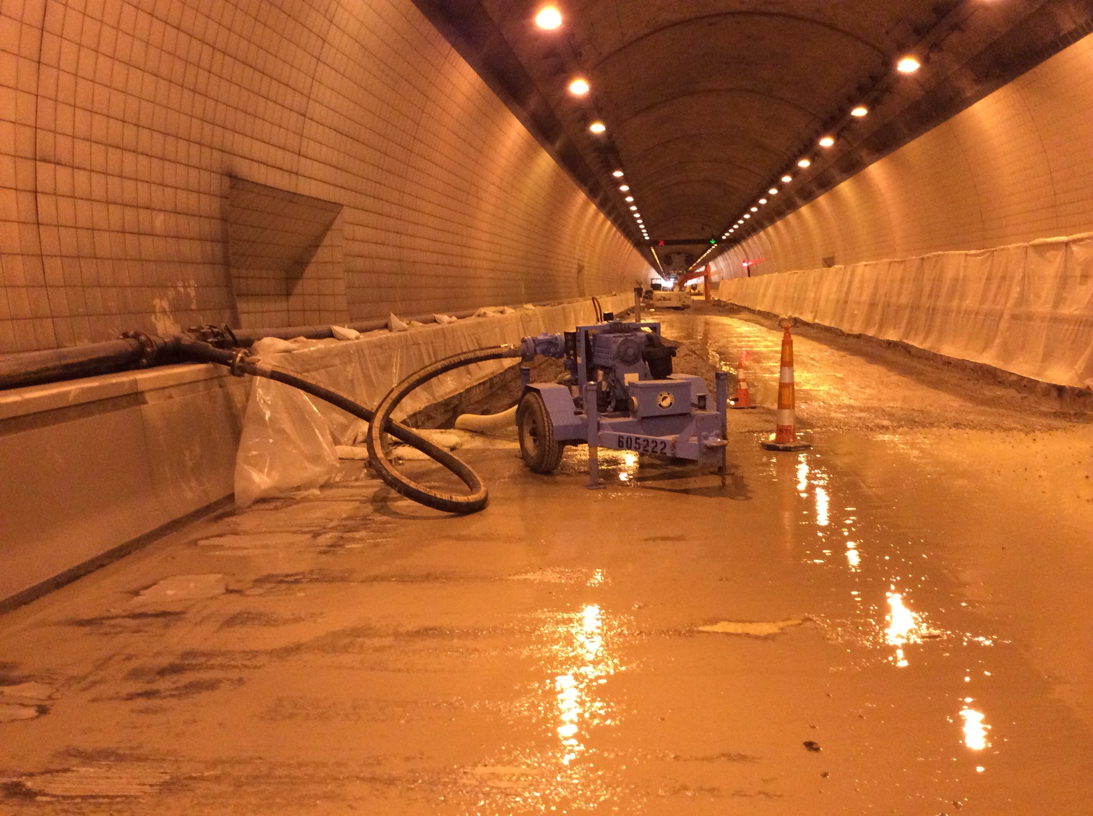
Water Pump
Notes:
Diesel Trash pump (1 of 3 on site) used to remove groundwater. 790 GPM via 6” HDPE Fused Pipe.

Slide 36
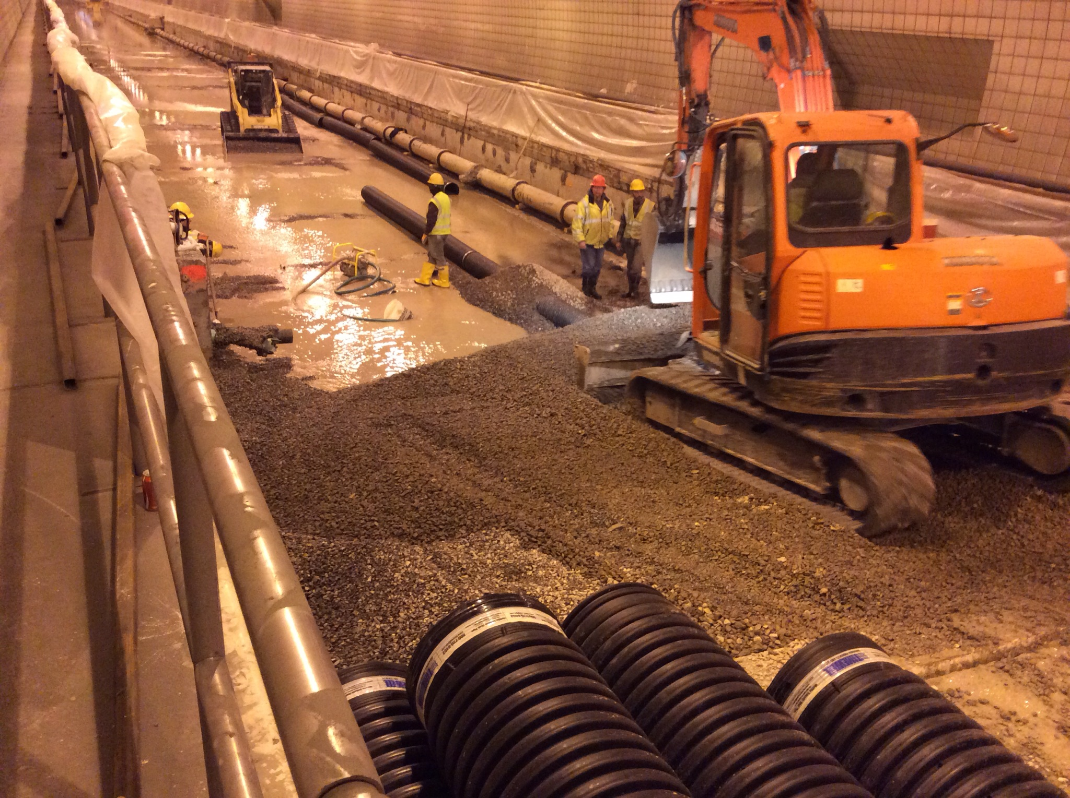
Granite Refill
Notes:
12” HDPE Pipe to daylight into existing groundwater drains.

Slide 37
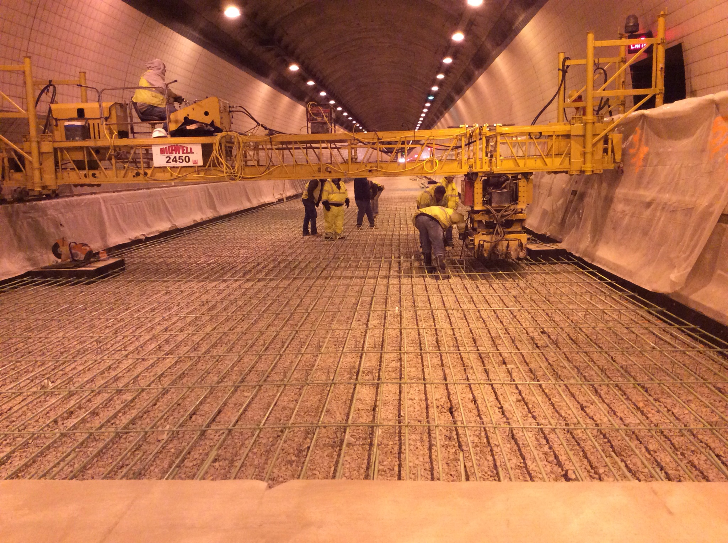
Bidwell Finishing Machine

Slide 38
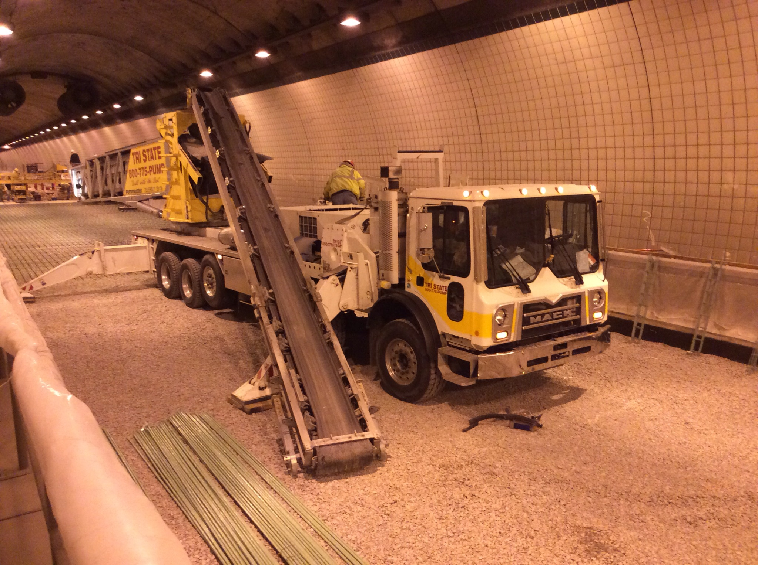
Telebelt Conveyor System

Slide 39
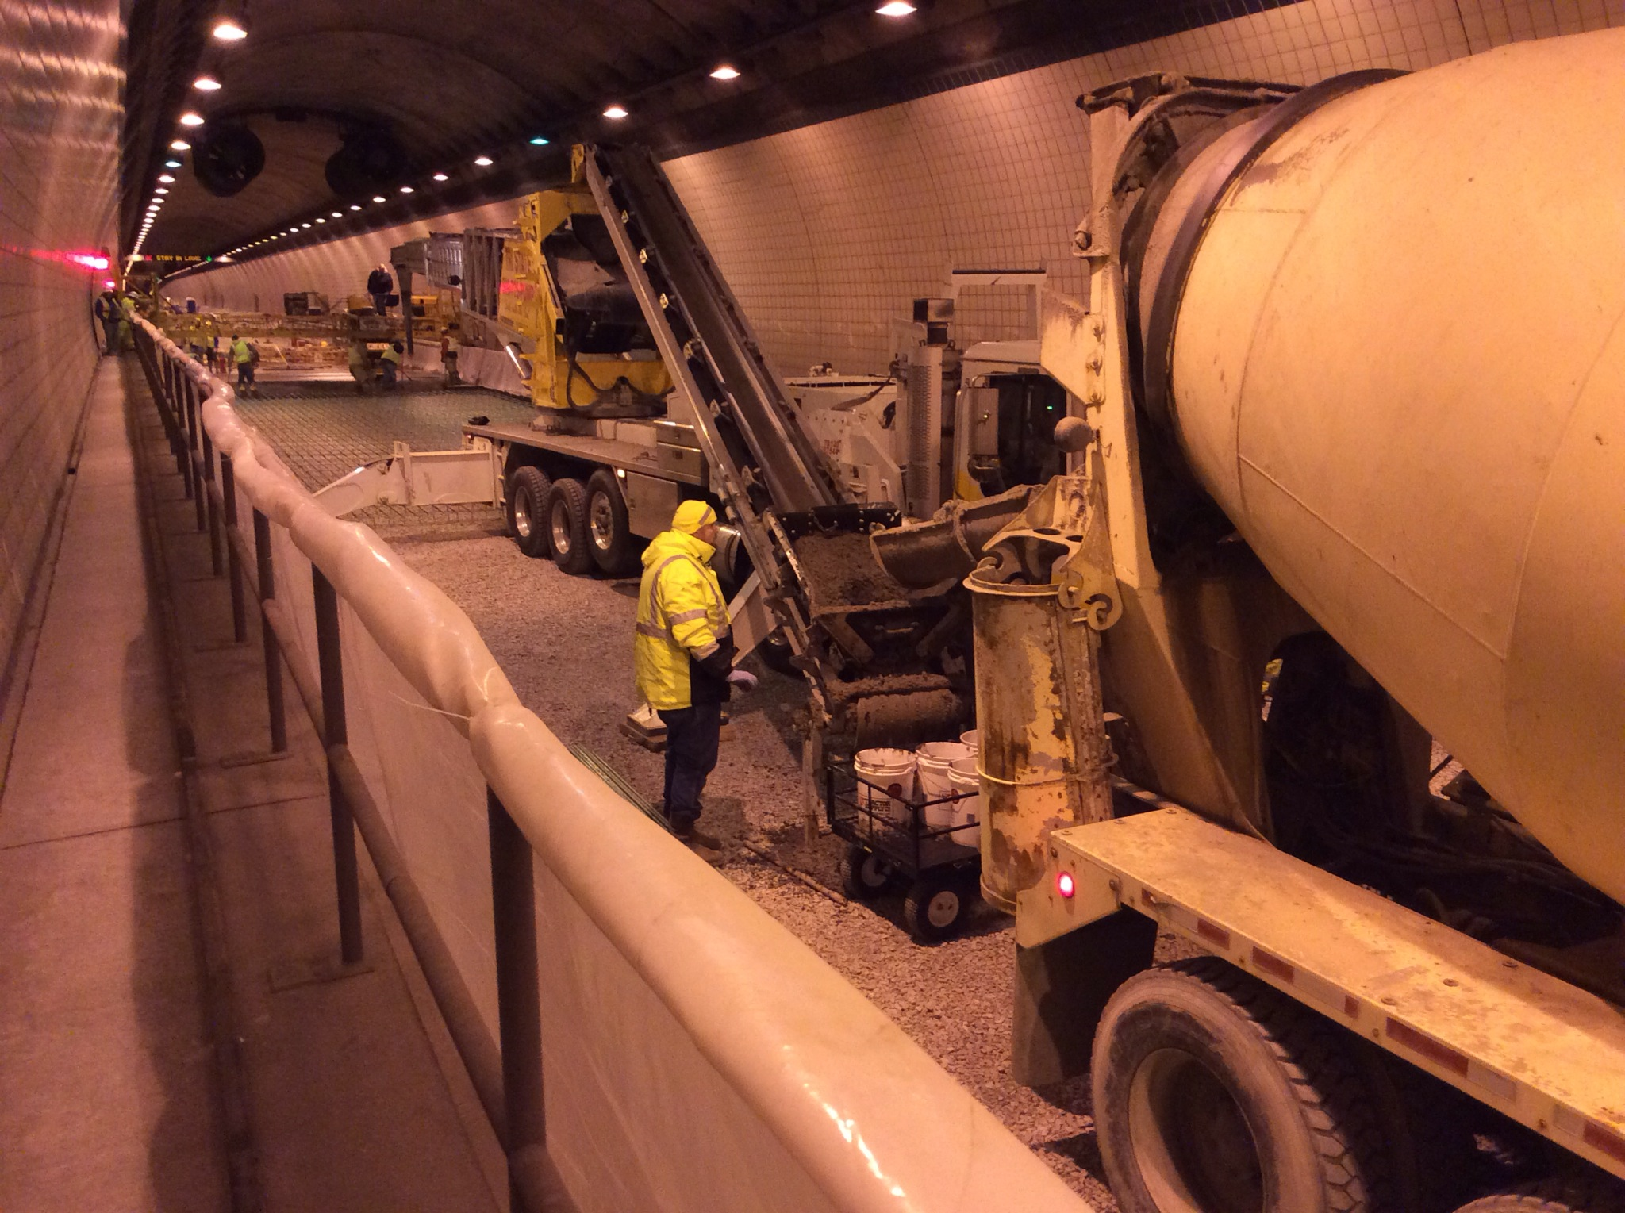
Telebelt Conveyor System

Slide 40
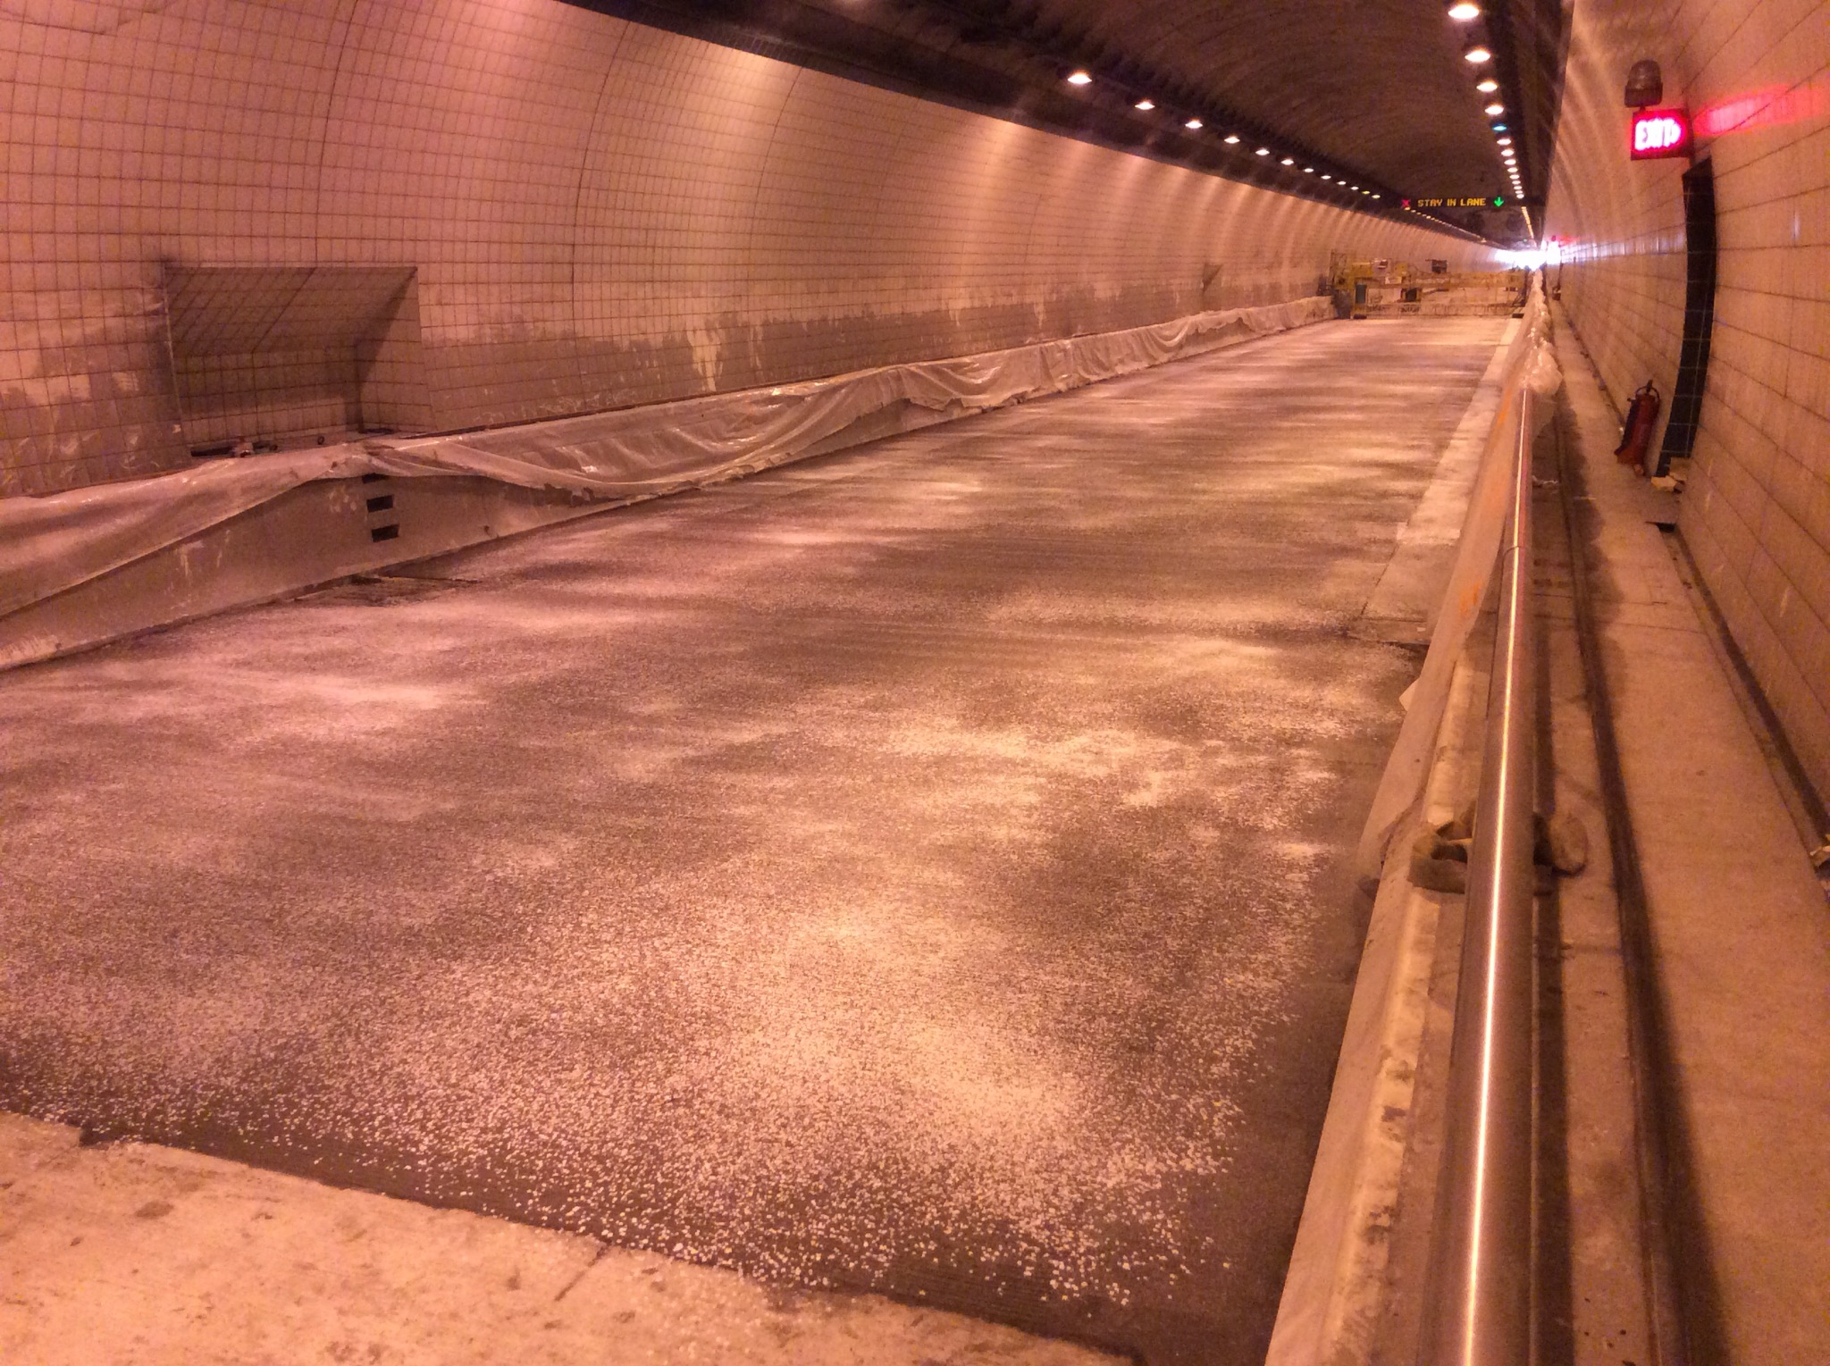
Poor Curing Compound Coverage

Slide 41
Additional Work Items…
Diamond Grinding
Re-sealing Joints
Upgraded Crash Cushions
New RPM’s

Slide 42
Project Survival…
7 Claims - $120k Administrative Settlement
High Turbidity From Groundwater
NOV Settlement

